Slide 1
Reflections. Metaprograming.
Kostiantyn Malinovskiy

Slide 2
Reflections/Agenda
  About Reflections
  Looking at Objects
  Looking Inside Objects
  Looking at Classes
  Looking Inside Classes
  Calling Methods Dynamically
  Tracing Your Program's Execution
  How Did We Get Here

Slide 3
  About Reflections
Allows:
what objects it contains,
the current class hierarchy,
the contents and behaviors of objects, and
information on methods.

Slide 4




Looking at Objects
=>
=>
ObjectSpacedoesn't know about objects with immediate values: Fixnum, true, false, and nil.

Slide 5

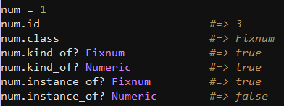
Looking Inside Objects

Slide 6
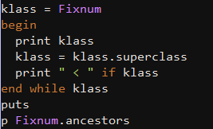
Looking at Classes

Slide 7
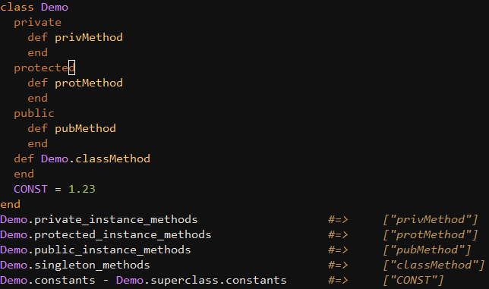
Looking Inside Classes

Slide 8

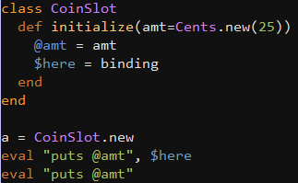
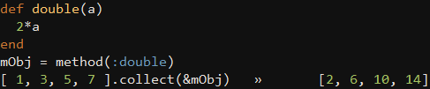


Calling Methods Dynamically

Slide 9
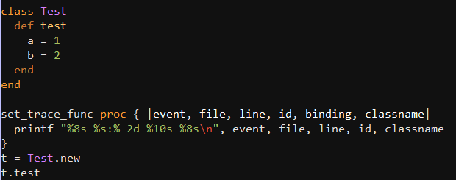
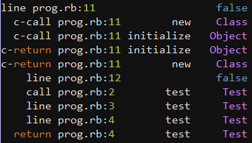
Tracing Your Program's Execution

Slide 10
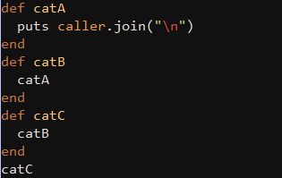

How Did We Get Here?
=>

Slide 11
Metaprogramming/Agenda
  About metaprogramming
  define_method
  method_missing
  Singletone methods
  Context
  class_eval
  instance_eval

Slide 12
About metaprogramming
Metaprogramming is writing code that writes code.

Slide 13
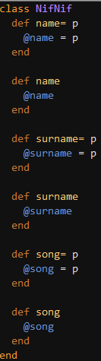
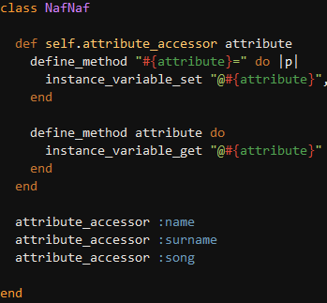
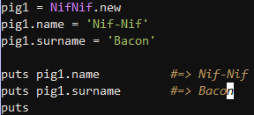
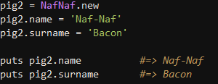
define_method

Slide 14
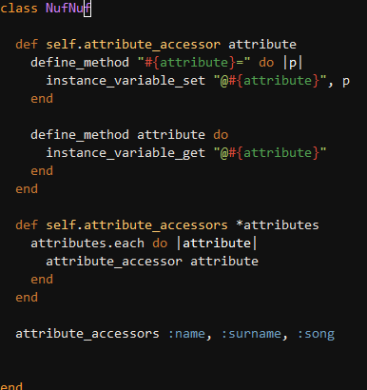
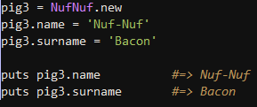
define_method

Slide 15
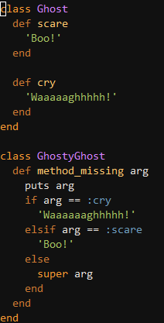

method_missing
Ghost
#method_missing :cry
…
GhostyGhost
#method_missing :cry
ghost

Slide 16
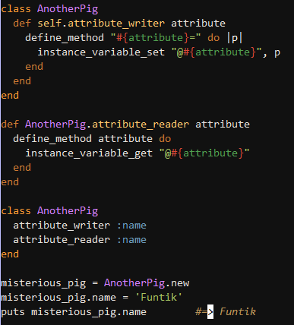
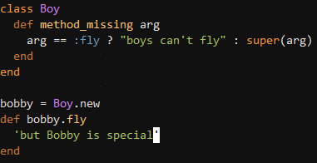

Singletone methods

Slide 17
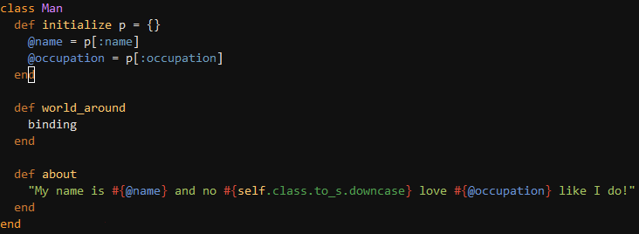
Context

Slide 18
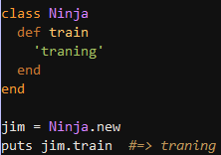
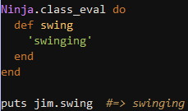
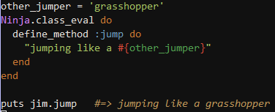
class_eval

Slide 19
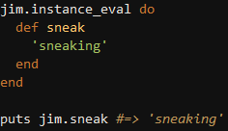
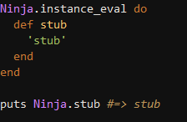
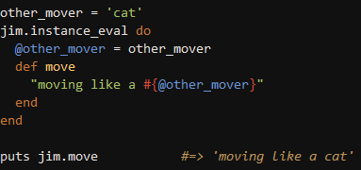
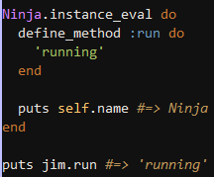
instance_eval

Slide 20
Useful links
http://ruby-doc.org/docs/ProgrammingRuby/html/ospace.html
http://yehudakatz.com/2009/11/15/metaprogramming-in-ruby-its-all-about-the-self/
http://weare.buildingsky.net/2009/08/25/rubys-metaprogramming-toolbox
https://github.com/Kmalynss/presentations/blob/master/metaprograming.rb
And others ….

Slide 21

Questions?

Slide 22


